Slide 1


ClothBridge
Team Code : 301 220
1- Ahmed Abo El-Hassan 2-Mohamed Karam
3- Alaa Yasser 4- Roaya Mohamed
5- Malak Hany

Slide 2






Agenda
Problem
Empathy map
Design Requirements
SDG
Prior Solutions

Slide 3

Problem
Problem
What
Who
Why
Solution
A large number of low or limited-income groups are unable to buy clothes due to high prices.
Low-income individuals.
Clothing donors.
Charity Organizations.
Clothing is basic necessity, not a luxury.
It widens the gap between different social classes.
It reflects inefficiency in current support system.
Creating a website that offers affordable clothing for low- and limited-income groups, and also allows people who have extra clothes they do not need to donate them through the website.

Slide 4
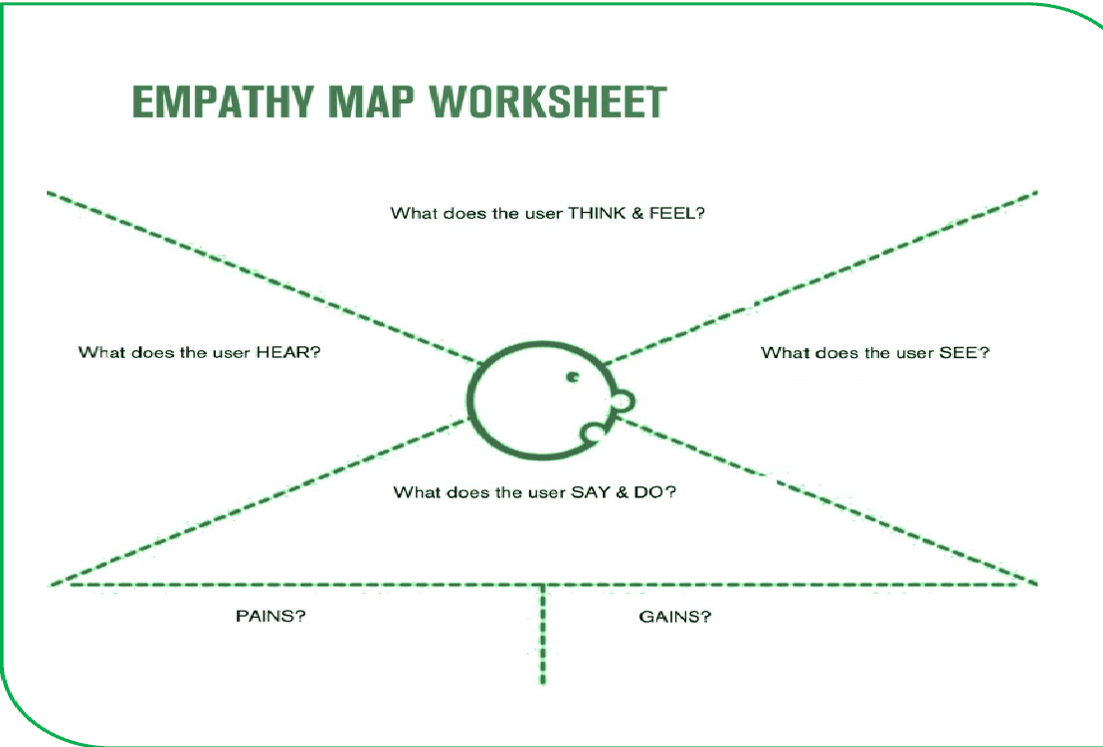
Empathy map
1.Concerned about rising clothing prices.
2.Looking for an any easy and secure way.
3.Wants to support his family on a limited budget.
1.Complaints about high prices.
2.Advice about donation places.
3.Experiences of people who faced the same problem.
1.High prices in the market.
2.Websites not designed for his situation.
3.Difficlty reaching charitable organizations.
1.Search for lower prices.
2.Compares prices before purchasing.
3.Use mobile phone for browsing
1.Limited budget.
2.Difficulty accessing a trusted source.
3.Fear of exploitation or insecurity.
1.Good-quality clothes at an affordable prices.
2.A trusted and easy platform.
3.Easy access through mobile devices.

Slide 5
Prior Solution
1.People used to buy clothes from traditional stores at normal or high prices.
2.There are some clothing donation websites, but they:
Focus only on donations without an organized purchasing system.
Are not specifically designed for low-income users.
3.Some platforms serve only one group, such as:
Websites dedicated only to charities.
Websites designed only for donors.
Websites that sell clothes only to the targeted beneficiaries.

Slide 6
Design Requirements
Functional
Registration Page
Non-Functional
Performance
Login Page
Home Page
Search & Filter
Contact Page
Donation Page
Shopping Cart
Security & Privacy
Usability & Accessibility

Slide 7

SDG
SDG 1 : No poverty :-
Its goal is to reduce poverty by providing clothes to people with low or limited income. This helps create equality and kindness between different social groups in the community.

Slide 8
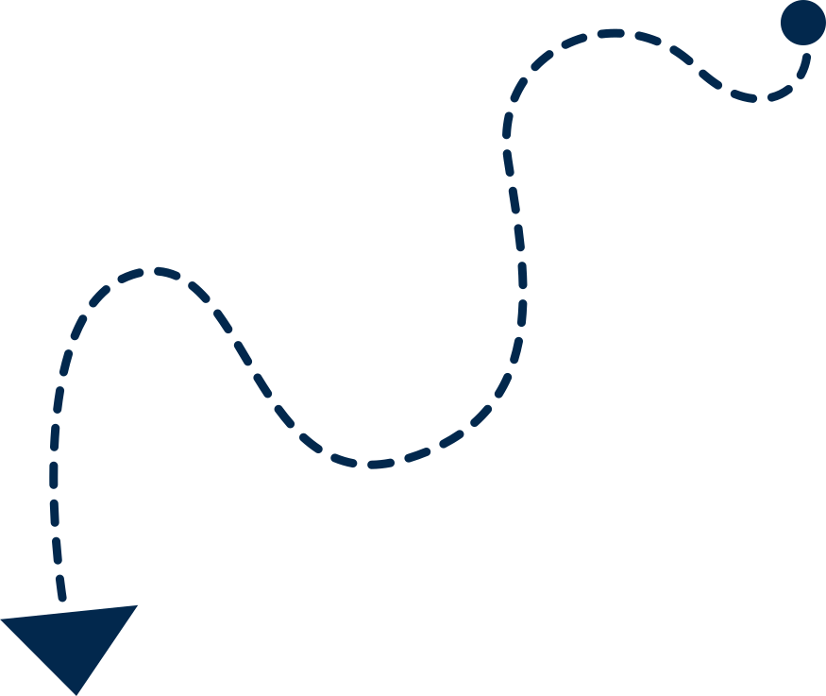
Prototype

Slide 9
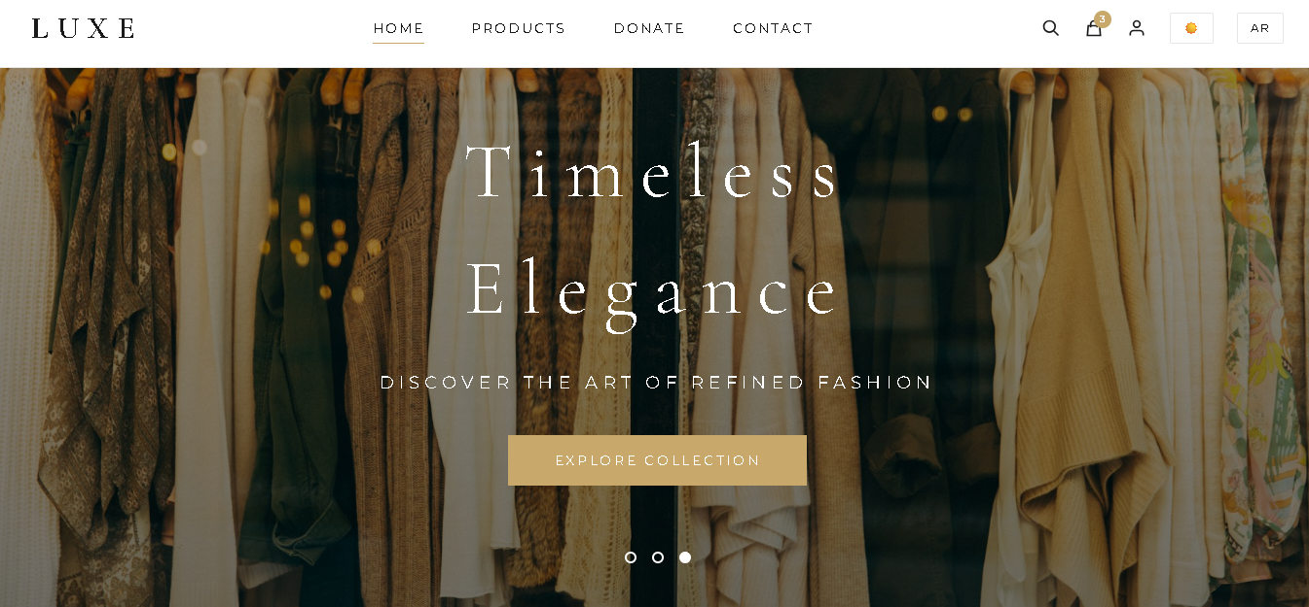

Slide 10

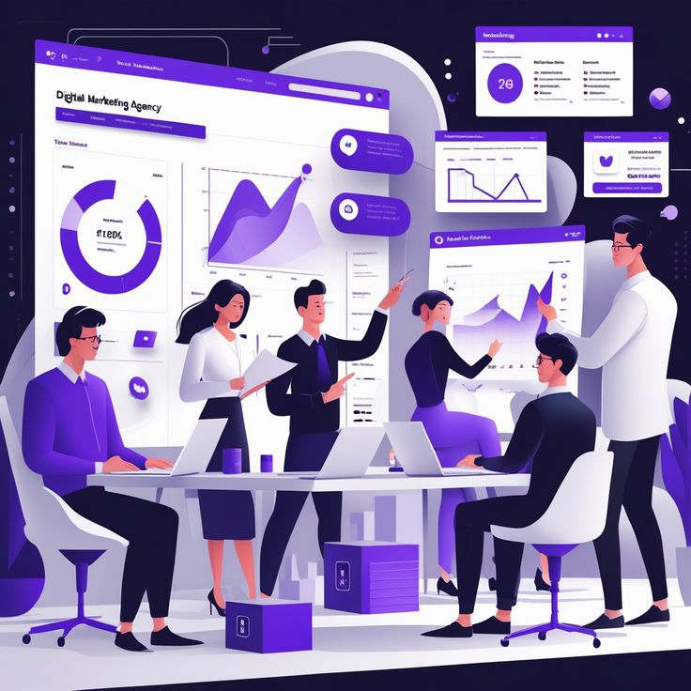
Thank You for Listening
Presented by :
Team 5
Supervised by :
Eng.Zyad Saeed

